Slide 1

Predicting MLB games using Machine Learning Classification
Flatiron School Module 3 Final Project
Kyle Johnson

Slide 2

Methodology
Obtain
Scrub
Explore
Model
Interpret

Slide 3

The Data
Sourced from:
baseball-reference.com
MLB Advanced Media API
Sportsbookreviewsonline.com

Slide 4
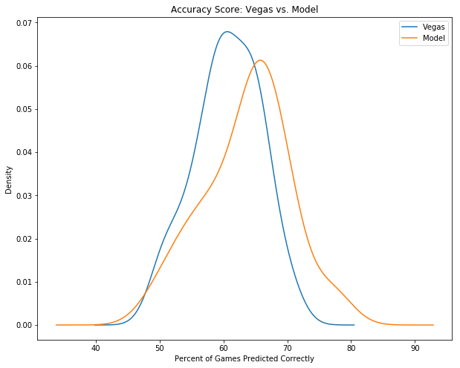
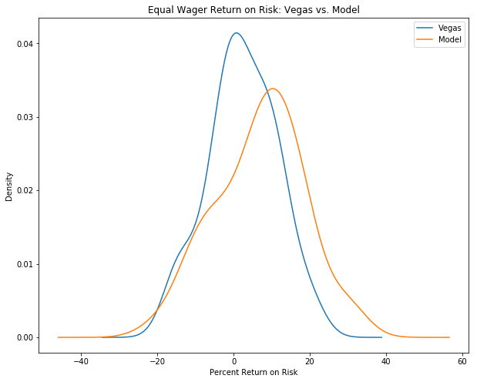
Findings: The model predicts a greater percentage of games correctly and achieves a higher return on risk in a statistically significant manner.

Slide 5
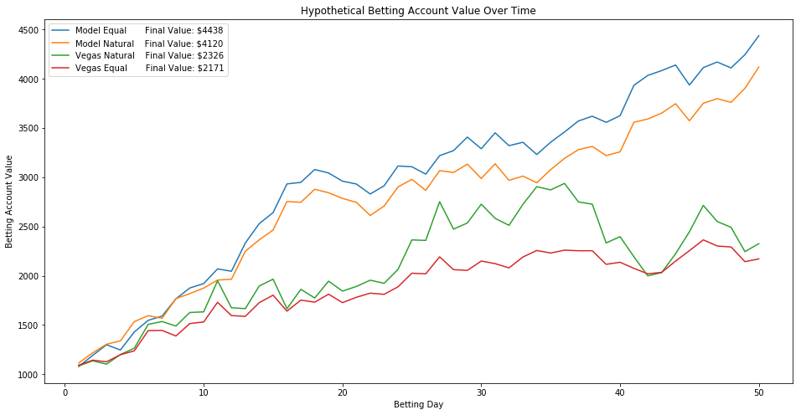
Hypothetical Application in the Sports Betting Market:

Slide 6

Conclusion
Model can predict MLB games with greater accuracy and betting return than the Vegas odds.
The model can potentially be used to earn profit in the sports betting market.

